Slide 1
Welcome to my class my dear students
Notes:
Welcome slide.

Slide 2
Introduction
Md Hasan Hafizur Rahman
Senior Lecturer & Head of the Department (English) Cambrian School & College, Campus-5, Baridhara, Dhaka | Lesson Description Class-VIII English 1st Paper
Notes:
Introduction.

Slide 3
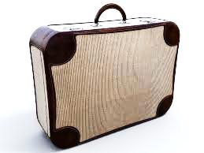
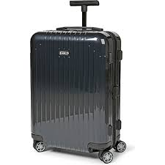
A suitcase without wheels
A suitcase with wheels
Can you say which one is easier to move and why?
Yes, a suitcase with wheel is easier to move because of its wheel.
Let us discuss about----
Notes:
Students may be asked about the pictures. They will explain about the role of wheel.

Slide 4
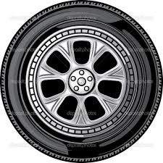
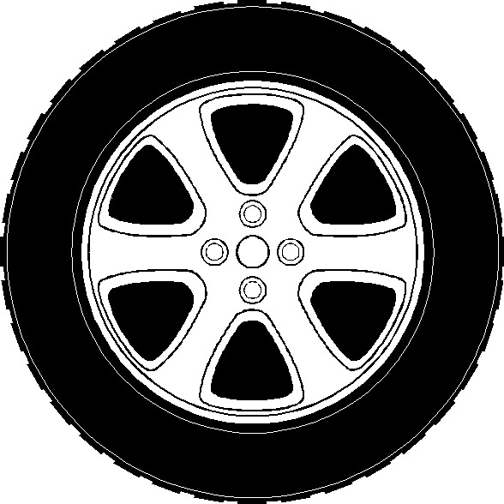
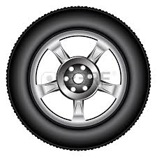
Wheel
Wheel
Wheel
Wheel
Notes:
Advance to the lesson.

Slide 5
The Wheel
Unit-9,Lesson-1
English For Today
Paper-1,Class-8
Notes:
Lesson declaration.

Slide 6
Learning outcomes
By the end of the lesson, students will be able to---
ask and answer questions
read and understand text materials
write a short paragraph
Notes:
All the fours skills will be focused here.

Slide 7
Not for the students
Teacher/students may read the topics loudly.
Notes:
Reading skill may be focused.

Slide 8
Let us know the key words from this lesson
Notes:
Notes: Teacher may show the word first and ask students to tell meaning then teacher can show the meaning to make them clear.

Slide 9
round, spherical, rounded, globular
Circular
A wheel is a circular object.
Notes:
The teacher may ask the meaning of the word then show the picture and then he can ask the students to make a sentence with the given word.

Slide 10
Rotate
interchange, revolve
A wheel is rotated around at its axis.
Notes:
Teacher may advance according to animation.

Slide 11
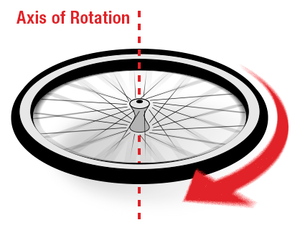
Axis
alliance, bloc, federation
A wheel is rotated around at its axis.
Notes:
Teacher may advance according to animation.

Slide 12
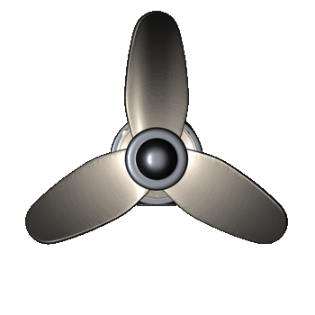
A propeller is a type of fan that transmits power by converting rotational motion into thrust.
Propeller
something rotate
Notes:
Teacher may advance according to animation.

Slide 13
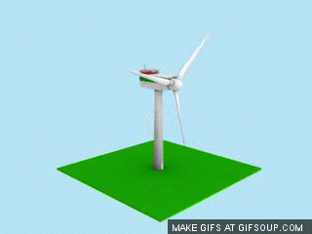
Turbine
Turbine is a kind of wheel.
Notes:
Teacher may describe about turbine in details.

Slide 14
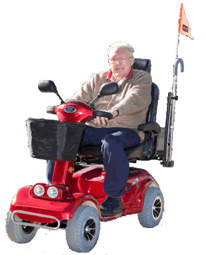
Mobility
Motion/speed
The mobility of our thinking is increasing day by day.
Notes:
Teacher may advance according to animation.

Slide 15
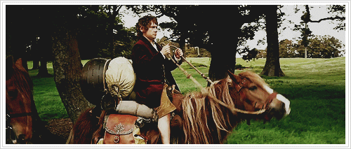
Journey
Meaning
Trip/Voyage
Always take a safe journey.
Notes:
Teacher may advance according to animation.

Slide 16
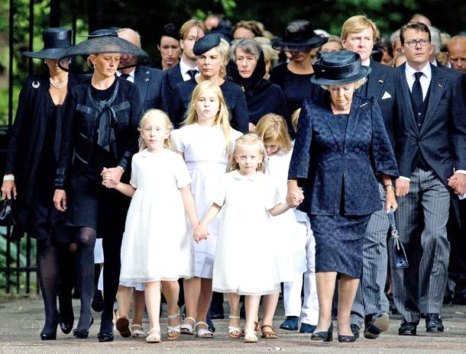
Civilisation
A gradual development of era.
We are passing modern civilisation.
Notes:
A focus from ancient time to present age may be mentioned with the pictures accordingly.

Slide 17
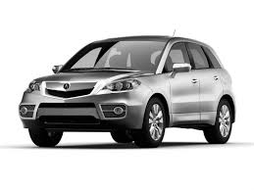
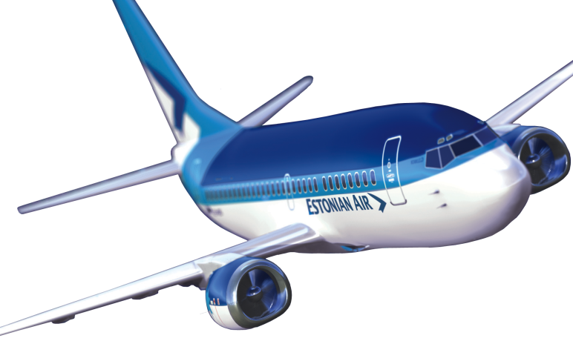
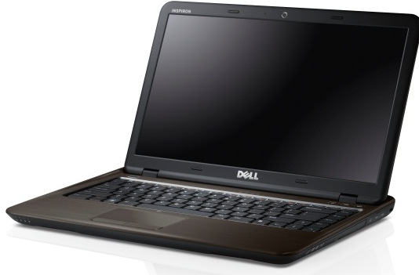
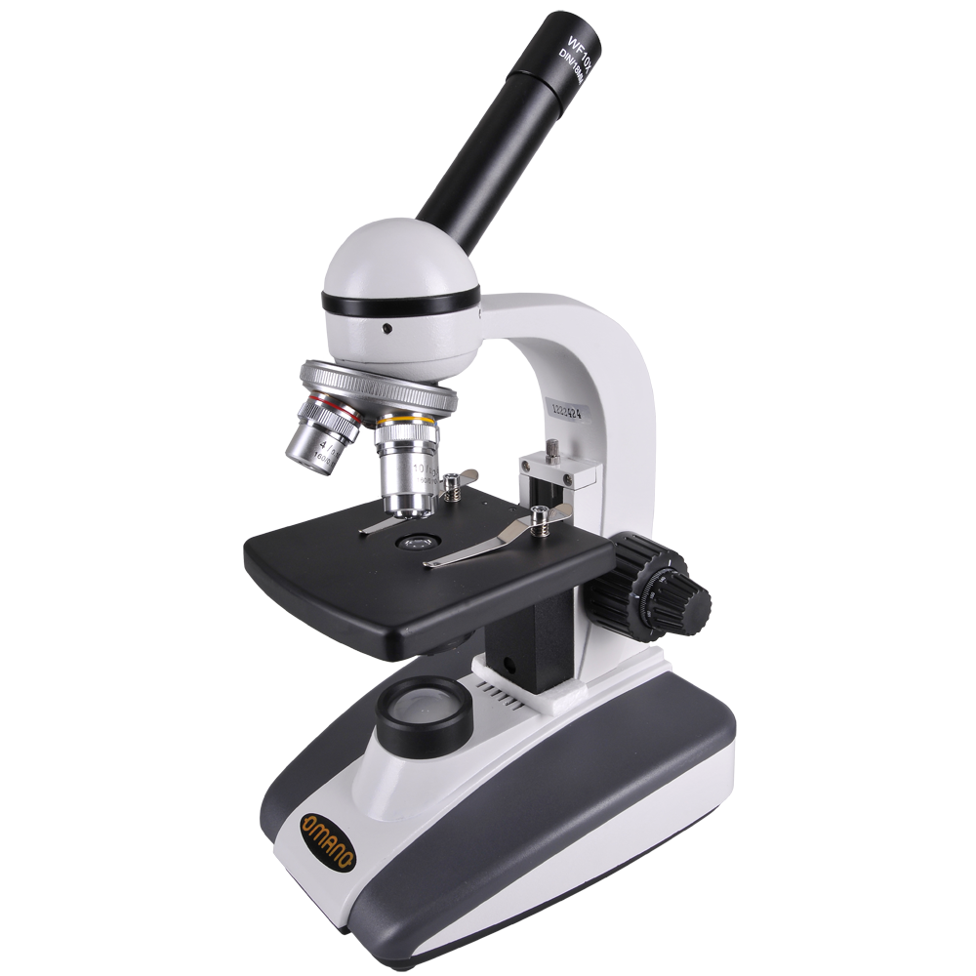
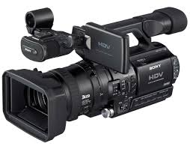
Computer
Car
Plane
Mobile phone
Microscope
Camera
Human beings have invented many important things so far. They have brought great civilization to the world through these inventions.
Notes:
Teacher may show the pictures accordingly and then make a combination with the text.

Slide 18
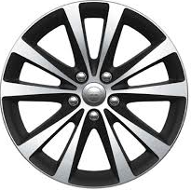
Do you know which invention is the greatest?
It is ‘the wheel’
Notes:
Teacher may ask about the picture to take out the answer ‘wheel.’

Slide 19
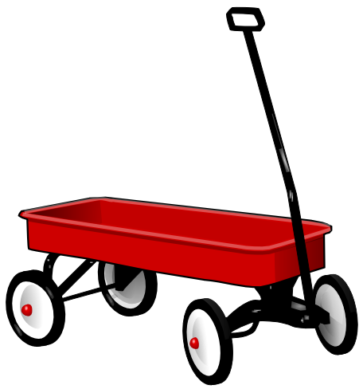
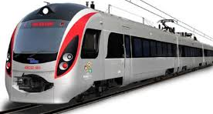
The wheels are, in fact, everywhere.
They are on-
cars
trains
wagons and so on.
Notes:
Different sectors of wheel.

Slide 20
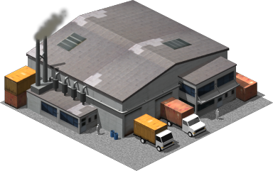
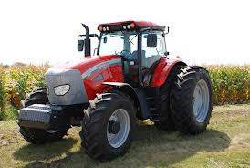
Besides, they are on most-
factories
farm equipment
Notes:
Even in the factories.

Slide 21
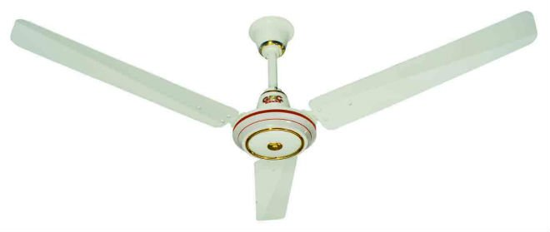
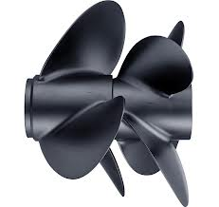
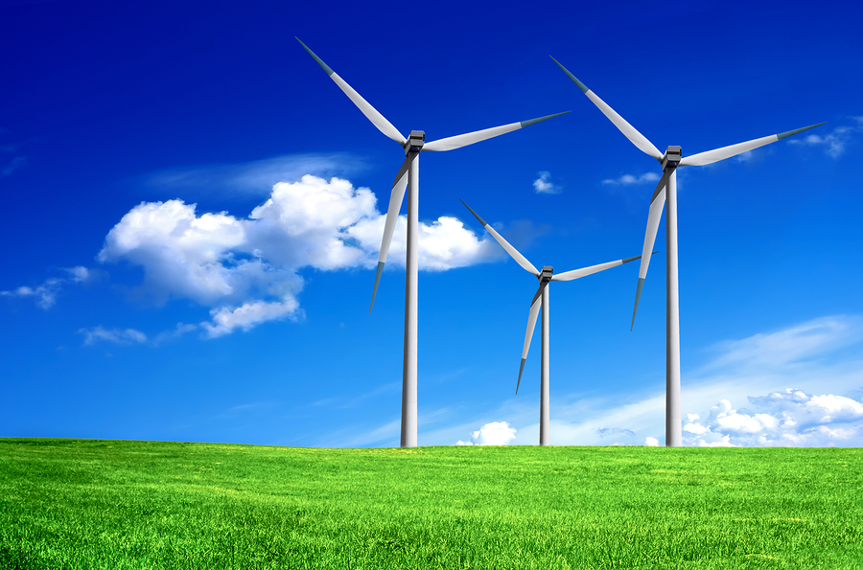
propellers
fans
turbines
So the wheel is very important. We cannot imagine modern life without wheels. But do we know exactly who made the first wheel?
Notes:
Teacher may read out the text loudly with proper pronunciation and intonation.

Slide 22
Read the text silently and answer the questions below.
What is a wheel?
What can a wheel do?
Where can you find wheels?
Notes:
Evaluation.

Slide 23
Individual work
C Fill in the blanks with appropriate words from the box. There are more words than necessary.
Although the wheel is a very (a) _________ invention, the history of its origin is unknown. Experts guess that the first wheel was developed from a circular object. The early man observed that a huge piece of stone could be rolled easily if it was (b) ________in shape. Similarly, a heavy tree-trunk is (c) _______ to carry; but it can be rolled away with less effort. Even, a gigantic tree-trunk can be moved easily using other small and round trunks as rollers under it. Thus, early man took advantage of rolling objects and developed the (d) _____ wheel. Apart from its mechanical advantage, a wheel's mobility has contributed (e) _____to the civilisation.
difficult | much | circular | important | heavy | first
important
circular
difficult
first
much
Notes:
Evaluation

Slide 24
Work in pair
D. Make as many correct sentences as you can using the substitution table. In the third column there are more items than necessary.
1. The wheel |  | a type of wheel.
2. A plain wheel | is | around its axis.
3. It | has | one of the simplest machines.
4. A propeller | rotates | wheels on vehicles and machines.
 |  | helped in rapid progress of civilisation.
Example: The wheel rotates around its axis.
Notes:
Teacher may ask the students to match the table.

Slide 25
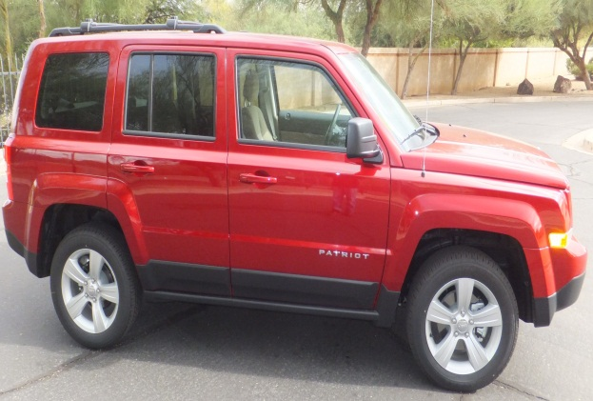
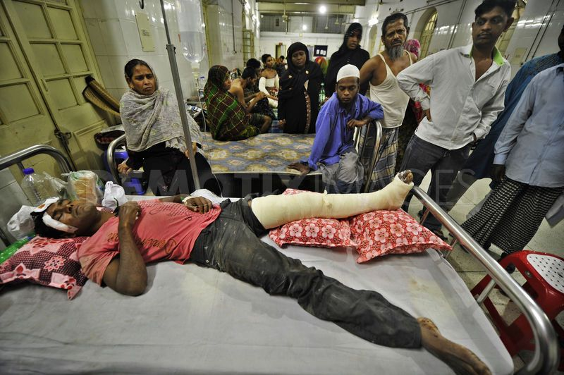
Home Work
E. Have you ever travelled by bus or car? Do you have any experience of what happens if one wheel falls flat. If yes, give a description of your experience. If no, imagine such a situation, and write a paragraph about it.
Notes:
Teacher may give a short description how to do home work on section E.

Slide 26
No more today
Allah Hafez
Notes:
Finishing slide.

Slide 27
Acknowledgement
We would like to express our cordial gratitude to the Ministry of Education, Directorate of Secondary & Higher Education, NCTB, A2i and the panel of honorable editors ( Md. Jahangir Hasan, Assistant Professor (English) TTC, Rangpur, Ranjit Poddar, Associate Professor (English) TTC, Dhaka, and Urmila Khaled, Assistant Professor (English) TTC, Dhaka, to enrich the contents.

